Slide 1
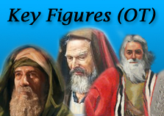
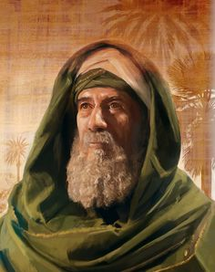
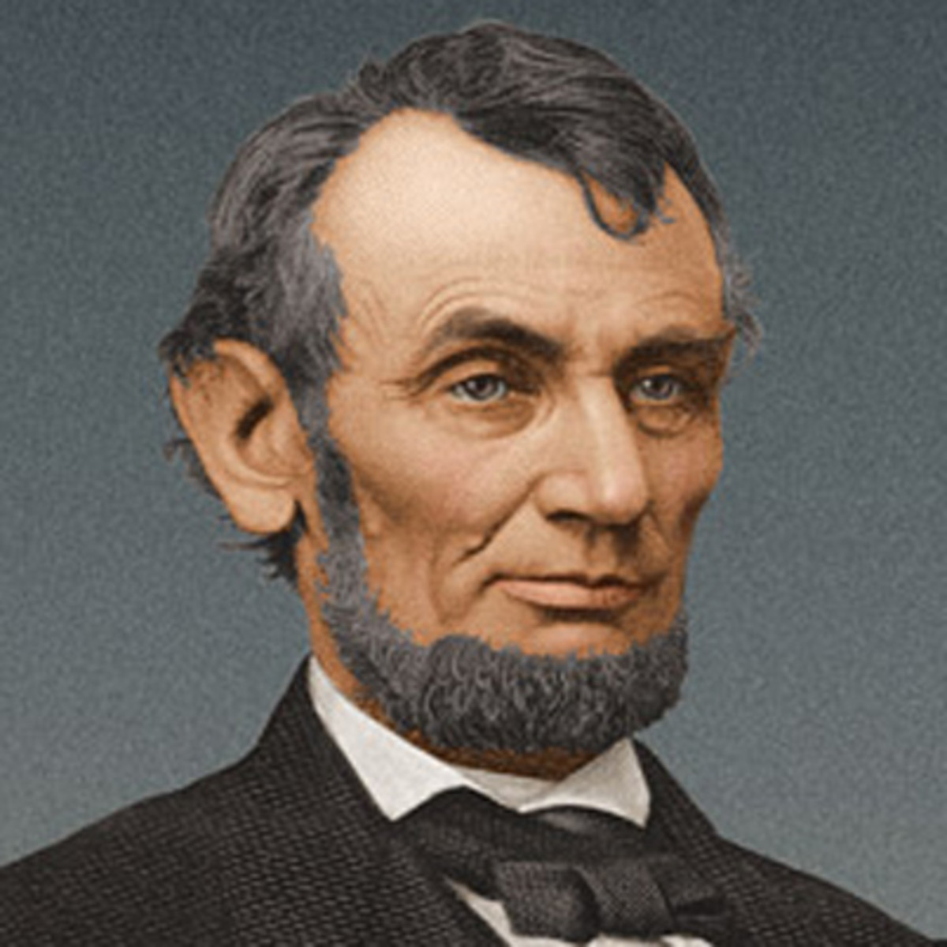
Key Figures in the Old Testament
#1: Abraham
Genesis 11:27 - 25:11

Slide 2
Key Figures in the Old Testament
#1: Abraham
Genesis 11:27 - 25:11

Slide 3
A “potted” history
Abraham
Moses
1500bc
David
1000bc
End of OT
500bc
Jesus
0
Catholic
500
Normans
1000
Reformation
1500
Us
2,000
2,000bc

Slide 4
Family Tree
Nahor
Terah
Sarai
Abram
Nahor
Haran
Lot

Slide 5
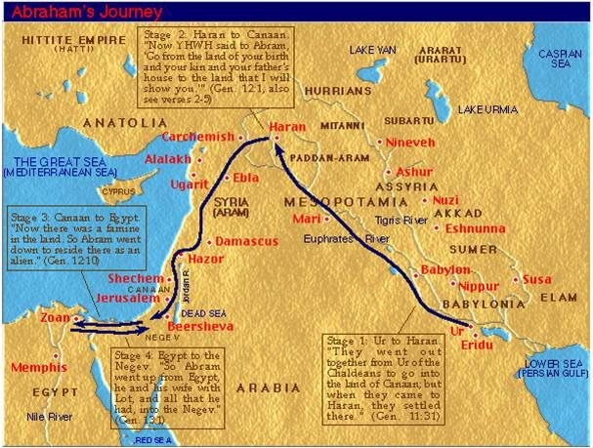
Where were they?

Slide 6
Genesis 11:27 – 12:10
Abraham’s Life
Born in Ur of the Chaldeans
Marries his half-sister Sarai
Moves with his father and Lot to Haran, where his father dies
God tells Abram to go to Canaan, and he and Lot go to Shechem
God promises the land there to Abram’s descendants

Slide 7
Genesis 12:11 - 20
Abraham’s Life
There is a famine so Abram goes to Egypt
Worried that the Egyptians will kill him to have Sarai, tells her to say she is his sister
Pharaoh takes Sarai into his household, paying Abraham for her
God afflicts Pharaoh
Pharoah returns Sarai and banishes Abram

Slide 8
Genesis 13 & 14
Abraham’s Life
Abram and Lot separate: Lot to region of Sodom and Abram to Hebron
There is a local war and Lot is taken captive
Abram takes 318 trained men and rescues Lot
On his return he is greeted by Melchizedek, king of Salem

Slide 9
Genesis 15 – 16:4
Abraham’s Life
God again promises the land to Abram’s (non-existent) descendants
When Abram questions, God confirms with an oath
Sarai, getting impatient, gives her servant Hagar to Abram
Hagar becomes pregnant

Slide 10
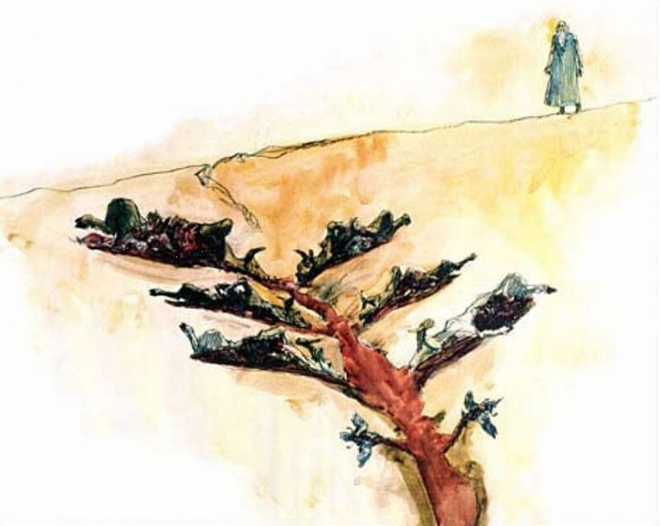
Genesis 15 – 16:4
Abraham’s Life

Slide 11
Genesis 16:5 – 16:16
Abraham’s Life
Animosity increases between Sarai and Abram over Hagar
Hagar flees but is sent back by an Angel
God promises that Ishmael will have many descendants
Hagar returns and gives birth to Ishmael

Slide 12
Genesis 17
Abraham’s Life
God makes a covenant with Abram and changes his name to Abraham
Circumcision is the sign of the covenant
God promises a child through Sarai, whom he renames Sarah
When Abraham is sceptical, God says it will happen when he returns in a year

Slide 13
Genesis 18:1 - 15
Abraham’s Life
Three “men” visit Abraham
Abraham has Sarah prepare them a meal
God confirms his promise of a son
Sarah laughs when she overhears
When asked why she laughed, she denies it

Slide 14
Genesis 18:16 - 33
Abraham’s Life
The “men” prepare to leave
God shares with Abraham that He intends to destroy Sodom and Gomorreh
Abraham bargains with God to save them (for Lot)
God agrees that He will not destroy them if 50 (45, 40, 30, 20,10) righteous are found there

Slide 15
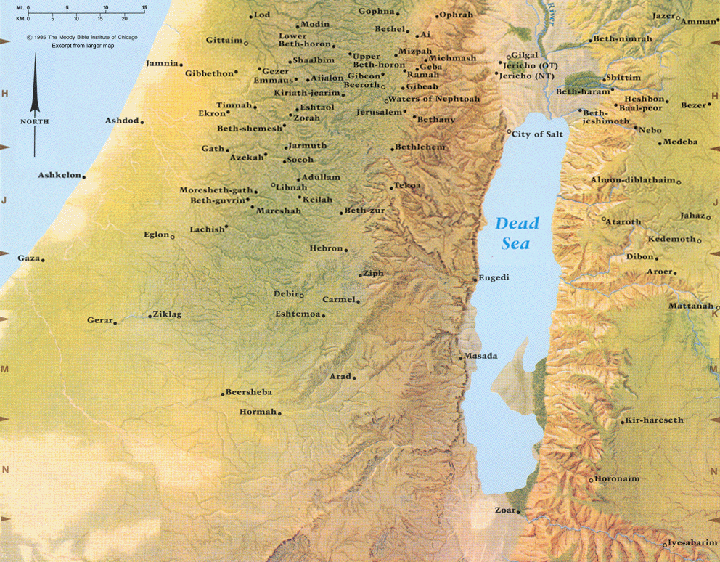
Genesis 18:16 - 33
Abraham’s Life

Slide 16
Genesis 19
Abraham’s Life
Angels visit Sodom and are hosted by Lot
The men of the city demand to have them
Lot refuses
Since only Lot is found to be righteous, God destroys the cities
Lot escapes but his wife looks back and is turned into a pillar of salt

Slide 17
Genesis 20
Abraham’s Life
Abraham moves to the Negev
Again, he convinces Sarai to say she is his sister
Abimelech king of Gerar takes her
God warns him in a dream
Abimelech returns Sarah

Slide 18
Genesis 21
Abraham’s Life
Sarah gets pregnant
Isaac is born
When Isaac is weaned, Sarah prompts Abraham to cast out Hagar and Ishmael
God protects them from harm
God repeats His promise to them

Slide 19
Genesis 22
Abraham’s Life
God tells Abraham to sacrifice Isaac
Abraham begins to do so but is stopped by an angel
A ram is supplied by God instead
God repeats His promise to Abraham

Slide 20
Genesis 23:1 – 25:11
Abraham’s Life
Sarah dies
Abraham purchases a cave to bury her in
Abraham arranges a bride for Isaac
Abraham marries Keturah and has 6 more sons
Abraham dies and is buried with Sarah

