Slide 1
End of the Southern Kingdom, Judah, 2 Kings: Chapters 24/25
Consequences of evil actions
Hope from God, the Royal line, Another chance?

Slide 2
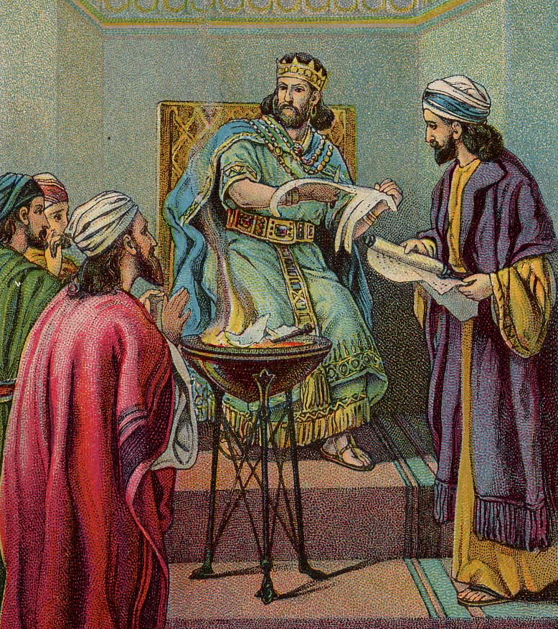
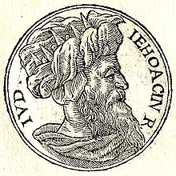
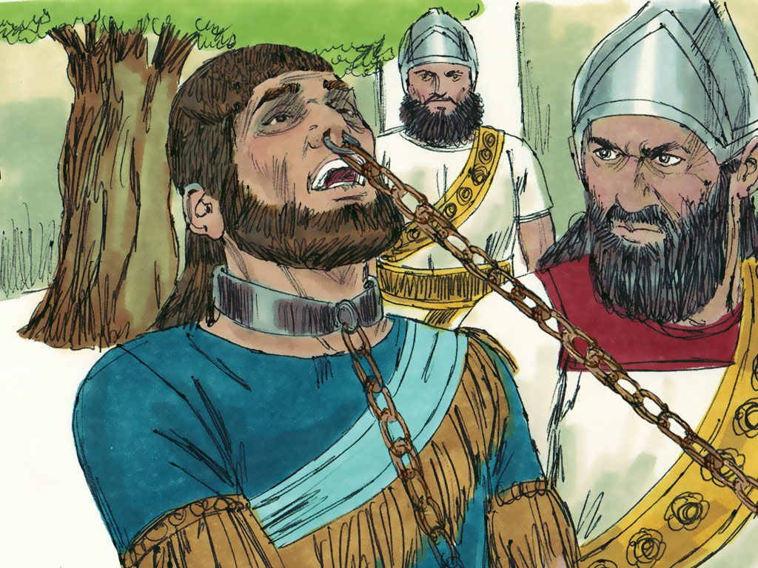
2 Kings, Chapter 24/25 End of the Southern Kingdom
God had previously given the Israelites what they wanted – a King, and they still went ahead with appointing Kings, despite God’s warning that having a King wouldn‘t end up well
King Jehoiakim ‘did what was evil in the sight of the Lord’ (end of 2 Kings 23)
The Lord had already decided, ‘to remove Judah (the Southern Kingdom) from His Presence’ due to the previous sins of an evil King Manasseh
Manasseh had ‘filled Jerusalem with innocent blood’ - this included, as well as worship of other gods, child sacrifice
When Jehoiakim died, his son Jehoiachin ruled (2 Kings, 24 v 8) – he did what was evil in God’s eyes
He was taken prisoner by King Nebuchadnezzar of Babylon

Slide 3
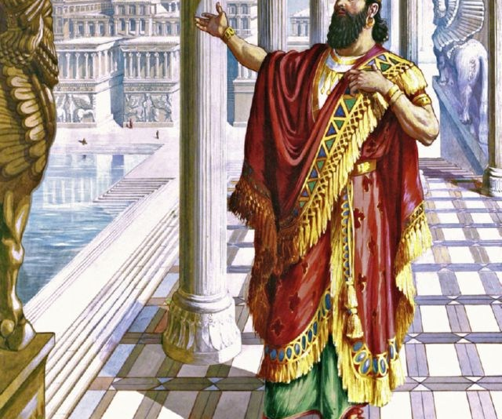
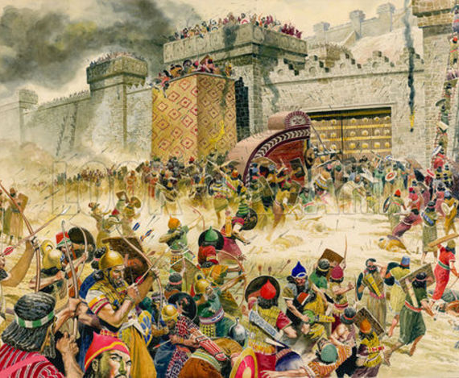
What was happening?
King of Babylon, Nebuchadnazzar was dominating the whole area, including Egypt
You ‘didn’t mess’ with Nebchadnazzar, but some of the Judaens went on to do just that

Slide 4
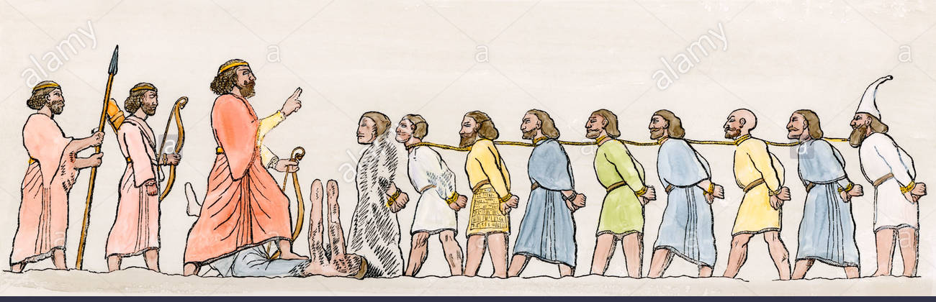
What was happening? Chapter 24 v 13 ff
King Nebuchadnezzar took thousands of people captive to Babylon
These were all the ‘best people’ eg, skilled craft workers and soldiers
All the treasurers from Yahweh’s temple were taken away/spoiled (v13)
Only the poorest people were left in Judah
King of Babylon appointed Zedekiah as the new King of Judah
Zedekiah did was evil
The Lord banished all the people of Judah into exile into Babylon

Slide 5
What Didn’t the Kings of Judah do?
They didn’t listen to God
They didn’t consult God, or His Prophets
They didn’t think about His laws
They didn’t seem to care about the spiritual health of Judah

Slide 6
What was happening? Chapter 25
10 min: Activity – Divide into 4 groups: Feedback what happened
Group 1 – Read and summarise v 1-7 – Fall of Jerusalem
Group 2 – v 8 – 21 - Destruction of the Temple
Group 3 – v 22-26
Group 4 – v 27 – 29
Then - discuss: In what ways, can we as Christians LISTEN to God?

Slide 7
Spiritual lessons
Judaens acted rebelliously and thoughtlessly, as though they had more power than they had, after all ‘they knew best’ Didn’t they?
Does that sound familiar to you?
Have you ever gone ahead with your own plans/decisions without taking notice of God’s love and guidance?
e.g., taken a new job, carried on in something you know God wants you to leave, given loads of your time to an activity that is damaging?
Ever carried on working and working and not given yourself any rest?

Slide 8
spiritual lessons – some examples
Ever kept on and on spending money on loads of stuff you know you can’t really afford/don’t need, and yet you still feel you need more stuff and you just keep doing it?
Ever spent loads of time on yourself and what you want to do, and been blind to the time needed to be spent with others?
Ever held a grudge for years?
You wouldn’t be alone – I’ve done some of these – acting like I should take all the decisions and making choices which were far from helpful
God longs for you to spend time focusing on Him – He wants to fill the empty space inside with a strong sense of love, security and satisfaction that makes other stuff pale into insignificance

Slide 9
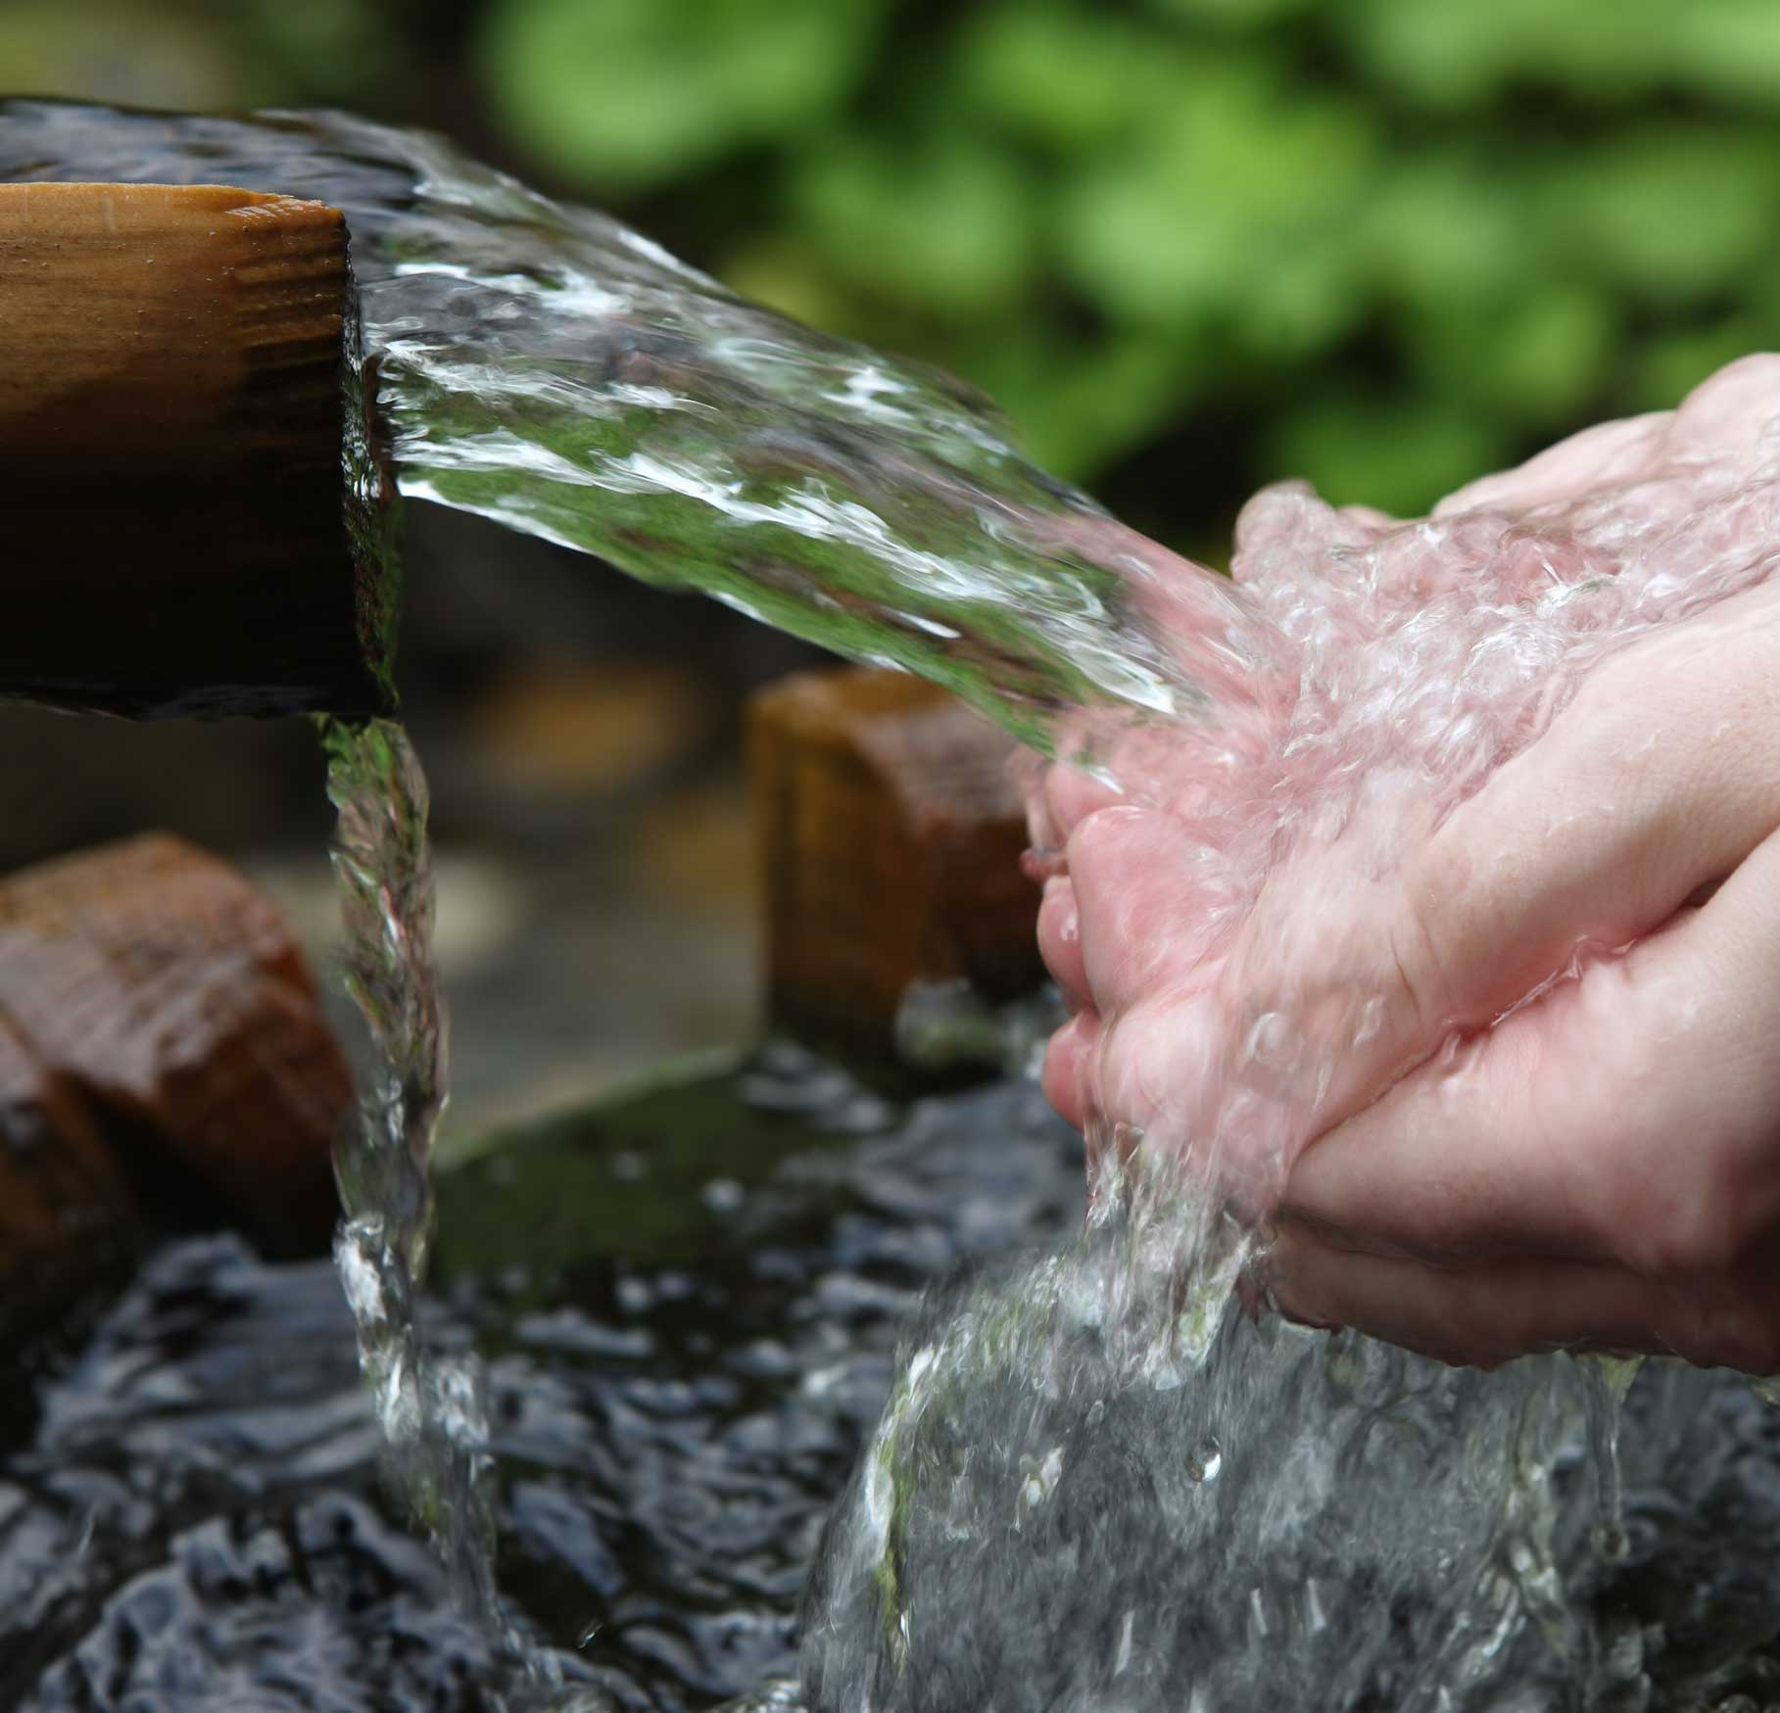
What can we learn from this?
That when our thoughts, feelings and heart are filled with loads of stuff that is where God SHOULD be, there is often no room, or little room for God – Yahweh
It’s rather like the ‘foreign gods’ worshipped by Judah, i.e., they filled up the spaces in their lives which should have been occupied by Yahweh – the true and living God – alone.
John 4 v 14 (NLT) - But those who drink the water I give will never be thirsty again. It becomes a fresh, bubbling spring within them, giving them eternal life.”
Don’t stifle the spring of water with dead wood and ‘foreign gods’ – let it form a joyous bubbling within you.
There is hope right at the end of 2 Kings Chapter 25, when King Jehoiachin was let out of prison and treated well – Jesus has ‘let us out of prison’ all the chains of sin and power of evil has been broken in our lives – it’s MARVELLOUS

