Slide 2
Mark 14
We are looking now at the final “death scene” in Mark
This is a problem for Mark (and the early Christians)
The problem is NOT that Jesus was executed
The problem is that he was executed by crucifixion

Slide 3
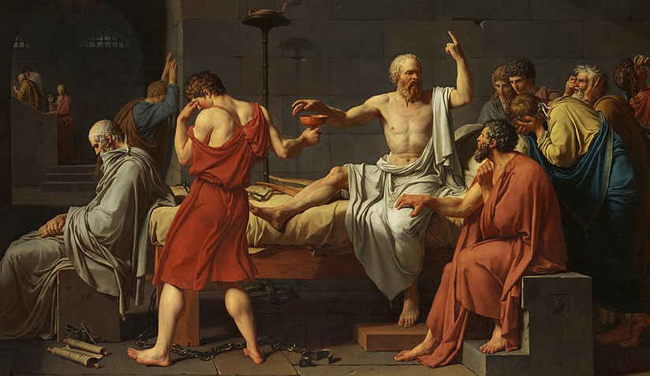
Socrates
“But come, Crito, let us obey him, and let someone bring the poison, if it is ready; and if not, let the man prepare it.” … And when Socrates saw him, he said: “Well, my good man, you know about these things; what must I do?” “Nothing,” he replied, “except drink the poison and walk about till your legs feel heavy; then lie down, and the poison will take effect of itself.” At the same time he held out the cup to Socrates... He raised the cup to his lips and very cheerfully and quietly drained it.
Up to that time most of us had been able to restrain our tears fairly well, but when we watched him drinking and saw that
he had drunk the poison, we could do so no longer …
But he said, “What conduct is this, you strange men! I sent the women away chiefly for this very reason, that they might not behave in this absurd way; for I have heard that it is best to die in silence. Keep quiet and be brave.”

Slide 4
Socrates
“Then we were ashamed and controlled our tears. He walked about and, when he said his legs were heavy, lay down on his back, for such was the advice of the attendant. The man who had administered the poison laid his hands on him and after a while examined his feet and legs, then pinched his foot hard and asked if he felt it. He said “No”; then after that, his thighs; and passing upwards in this way he showed us that he was growing cold and rigid. And again he touched him and said that when it reached his heart, he would be gone.
After a little while he moved; the attendant uncovered him; his eyes were fixed. And Crito when he saw it, closed his mouth and eyes.
Such was the end of our friend, who was, as we may say, of all those of his time whom we have known, the best and wisest and most righteous man.

Slide 5
Mark 14
Judean leaders seek a way to kill Jesus 14:1-2
Anointing in Bethany 14:3-11
Passover meal (last supper) 14:12-25
Peter’s denial foretold 14:26-31
Gethsemane and arrest 14:32-52
Jesus before the Sanhedrin 14:53-65
Peter’s denial 14:66-72

Slide 6
Mark 14:1-2
Two days later it was the Passover and the feast of unleavened bread. The chief priests and the scribes were looking for a way to trap him, seize him, and kill him. “But not at the feast,” they said, “lest it causes an uprising among the people.”

Slide 7
Mark 14:3-11
Jesus was in Bethany, in the home of Simon the leper, reclining at dinner when a woman came with an alabaster jar of costly pure nard ointment. Breaking the jar, she poured it on his head. Some of those there were indignant, “Why was this ointment wasted? It could have been sold for over three hundred denarii and that could have been given to the poor” they chastised her. But Jesus said, “Leave her be, why are you troubling her? She has done something good for me. You will always have the poor with you, and you can do good for them whenever you want, but you will not always have me.

Slide 8
Mark 14:3-11
What she has done is to anoint my body for the tomb ahead of time. I tell you the truth, wherever the good news is preached, through the whole earth, what she has done will be told in memory of her.” Judas Iscariot, one of the twelve, left for the chief priests, in order to betray him to them. When they heard, they rejoiced and promised to give him silver. Then he sought a good time to betray him.

Slide 9
Mark 14:12-25
On the first day of the feast of unleavened bread, when the Passover lambs are killed, his disciples asked him, “Where do you want us to go to prepare somewhere for you to eat the Passover?” He sent two of his disciples, telling them, “Go into the city, you will meet a man carrying a jar of water. Follow him. Where he goes in, say to that householder, ‘The teacher asks where the guest room is where he might eat the Passover with his disciples?’ He will show you a large upper room with the couches spread and everything prepared. Make ready for us there.” So, the disciples went into the city and found things just as he had said, and they prepared for the Passover.

Slide 10
Mark 14:12-25
When evening came, he came with the twelve. As they were reclining and eating, Jesus said, “I tell you the truth, one of you is going to betray me, one who is eating with me.” They began to be sad and asked him, one by one, “It is not I, is it?” He told them, “It is one of the twelve, one who is dipping bread into the bowl with me. On the one hand, the son of man is going, just as it is written about him, but on the other hand, woe to that man by whom the son of man is betrayed! It would have been better for him if he had never been born.”

Slide 11
Mark 14:12-25
As they were eating, he gave them bread, having taken, blessed, and broken it. “Take: This is my body.” He also took a cup and, having given thanks, he gave it to them, and they all drank from it. “This is my blood of the covenant, that is poured for many. I tell you the truth, I will not drink of the produce of the vine any more until the day when I can drink the new wine in the kingdom of God.”

Slide 12
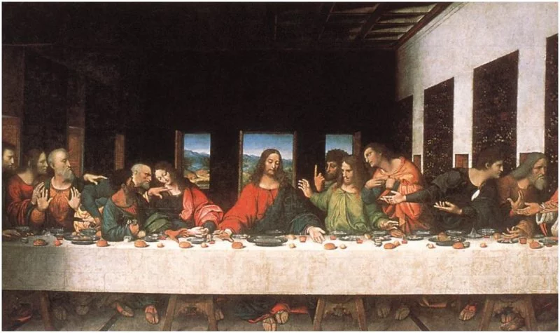
Meals
The last supper is, most famously, depicted by Da Vinci:

Slide 13
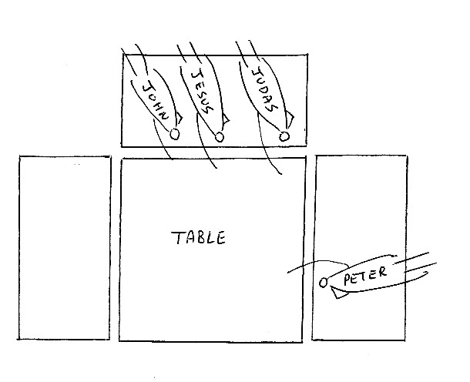
Meals
This is completely wrong (it shows a mediaeval style of banqueting).
In Judea they would have reclined to eat, probably in the Roman fashion.

Slide 14
Mark 14:26-31
Singing a psalm, they went out to the Mount of Olives. Jesus told them, “All of you are going to falter, as it is written, ‘I will strike the shepherd and the sheep will be scattered’. But after I am raised, I will go ahead of you into Galilee.” Peter replied, “Even if everyone else falters, I won’t!” Jesus said to him, “I tell you the truth, today, this very night, before the cock crows twice, you will deny me three times.” But he said, sorrowfully, “Even if I must die with you, I will never deny you.” And they all said the same.

Slide 15
Mark 14:32-52
He came to a place called Gethsemane, and he said to his disciples, “Sit here while I pray.” He took Peter, James, and John with him, and getting upset and anguished, he said to them, “My soul is very sorrowful, even to death. Stay here and keep watch.” Moving on a little way, he fell on the ground and prayed that, if it were possible, this hour should pass him by. “Abba, Father, everything is possible for you, take this cup from me. But, not what I want, rather, what you want.”

Slide 16
Mark 14:32-52
Coming back, he found them sleeping and asks Peter, “Simon, are you asleep? Are you not strong enough even to keep watch for an hour? Watch and pray so that you do not come to be tested! While the spirit is willing, the flesh is weak.” Going away again, he prayed the same thing he had before. Coming back again, he found them sleeping, for their eyes were heavy, and they didn’t know what to say to him.

Slide 17
Mark 14:32-52
The third time he returned he told them, “Sleep for what time remains and rest. It is enough. The time has come when the son of man will be handed over into the hands of sinners. Rise and let us go: Look, my betrayer is nearby.”

Slide 18
Mark 14:32-52
Even as he was saying this, Judas appeared, one of the twelve, with a crowd armed with swords and clubs sent from the chief priests, the scribes, and the elders. The betrayer had given them a signal: “Whomever I kiss, he is the one. Seize him and take him away securely.” As soon as he came to Jesus, he kissed him, saying, “Rabbi.” They laid their hands on him and seized him.

Slide 19
Mark 14:32-52
But one of those standing around drew a sword and struck the servant of the high priest, cutting off his earlobe. Jesus answered them, “You come with swords and clubs to arrest me as if I were a robber? Every day I was there in the temple teaching, and you did not seize me. But the scriptures must be fulfilled.”
Then they all abandoned him and fled.
A young man was there, having followed them, wearing only a nightgown over his nakedness, and the grabbed him but he left the nightgown behind and fled naked.

Slide 20
Mark 14:53-65
So, they brought Jesus before the high priest and all the chief priests, elders, and scribes gathered together. Peter had followed a little way behind until he was outside in the courtyard of the high priest. He was sitting with the attendants, warming himself at the fire.

Slide 21
Mark 14:53-65
The chief priests and the entire Sanhedrin were trying to find testimony against Jesus so they could kill him, but they could not find it. For, though many testified falsely against him, their testimonies were not in agreement. Then some stood up and lied against him, saying, “We heard him saying, ‘I will destroy this man-made holy place and in three days I will build another, without hands’. But even so, their testimony did not agree. The high priest stood up in the centre and questioned Jesus, “Do you not give an answer? What about what they testify against you?” But he was silent and did not answer.

Slide 22
Mark 14:53-65
Again, the high priest questioned him, “Are you the Christ, the son of the Blessed One?” Then Jesus said, “I am. You will see the son of man sitting on the right hand of the Power and coming with the clouds of heaven.” The high priest tore his coat, “Do we need more witnesses? You have heard his blasphemy; How does it seem to you?” They all judged him to be worthy of death. Some of them began to spit on him and cover his face and punch him, saying, “Prophesy!” The soldiers also hit him when they took him.

Slide 23
Mark 14:66-72
Peter was outside in the courtyard when one of the servant girls of the high priest came and, seeing Peter warming himself, she looked at him and said, “You also were with the Nazarene, Jesus.” But he denied it, “I don’t know, nor do I understand what you are saying.” He left and went out into the forecourt, and a cock crowed.

Slide 24
Mark 14:66-72
The servant girl saw him there and began to tell those standing around, “He is one of them.” Again, he denied it. A little while later those standing around said to Peter, “Surely you are one of them. You are Galilean, your accent betrays you.” But he began to swear and to curse, “I do not know this man you are talking about!” At that, the cock crowed a second time. Peter remembered what Jesus had said to him: “Before the cock crows twice, you will deny me three times”, and thinking on that, he wept.

